Slide 1
Data Engineer Test
Muhammad Jauhar Hakim
https://github.com/Jauhar-Hakim/Data-Engineer-Test

Slide 2
01
Create a Star schema of the Origin Sakila Database

Slide 3
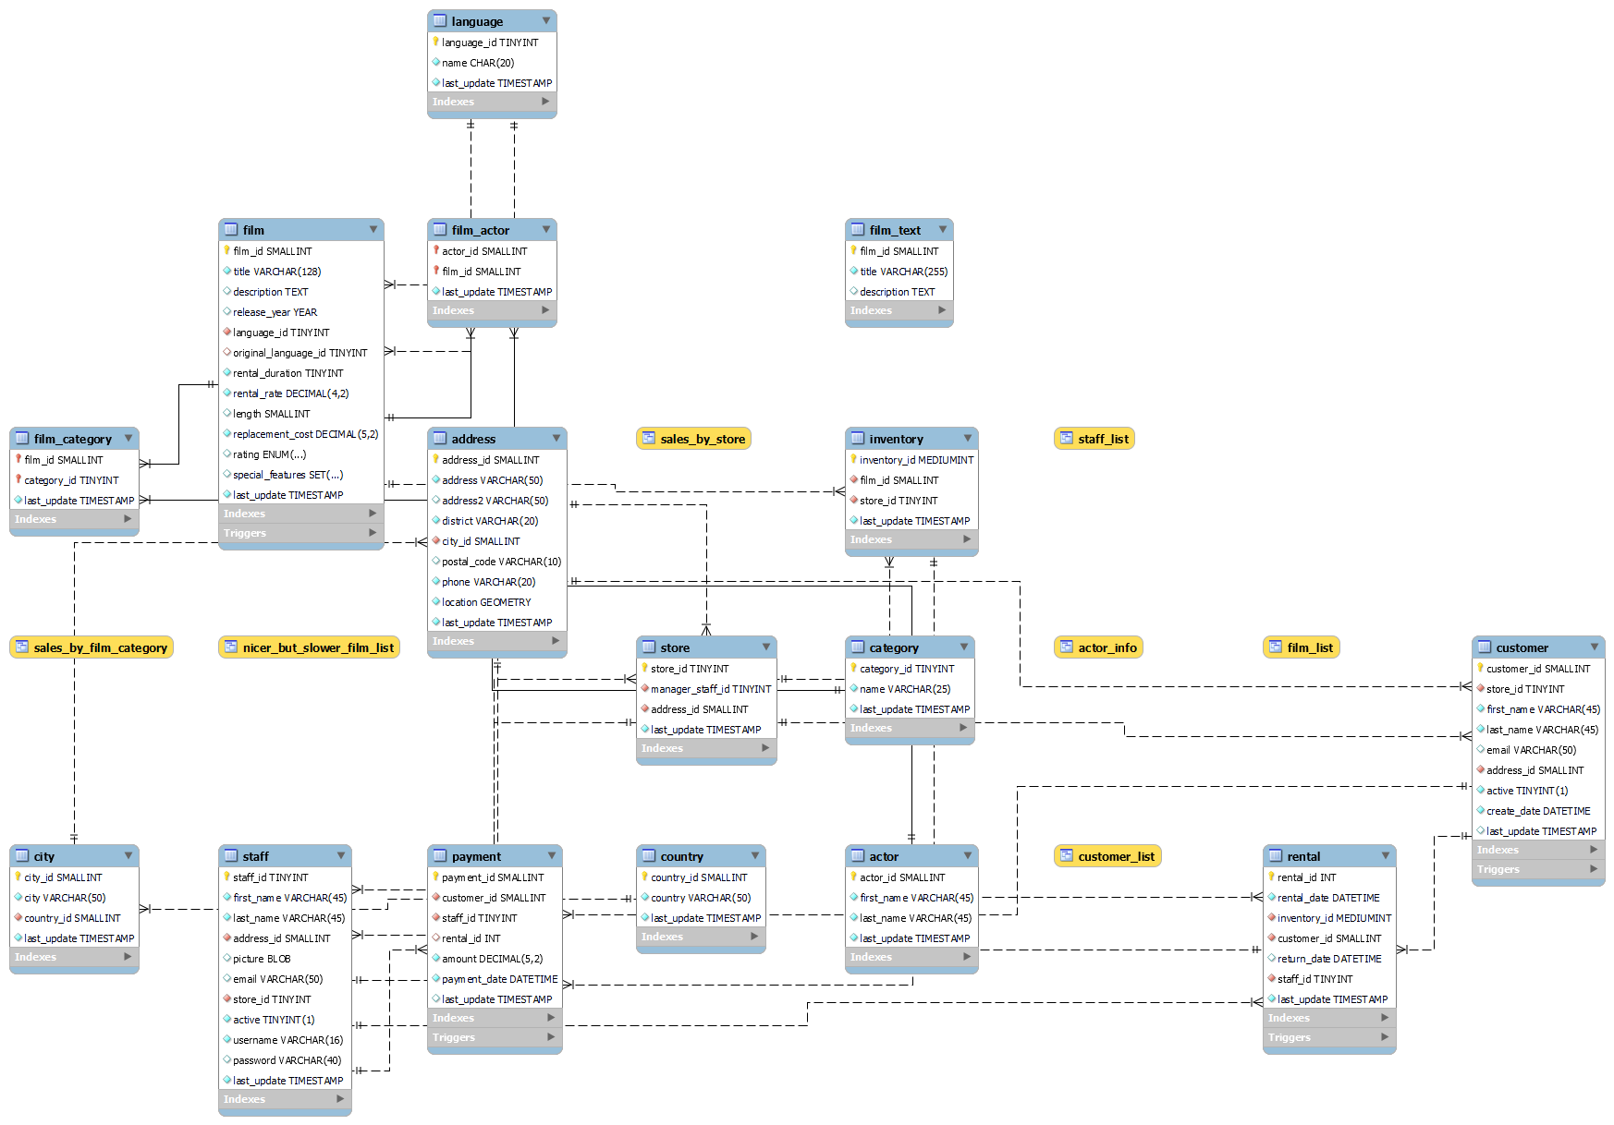
Origin Schema of Sakila Database

Slide 4
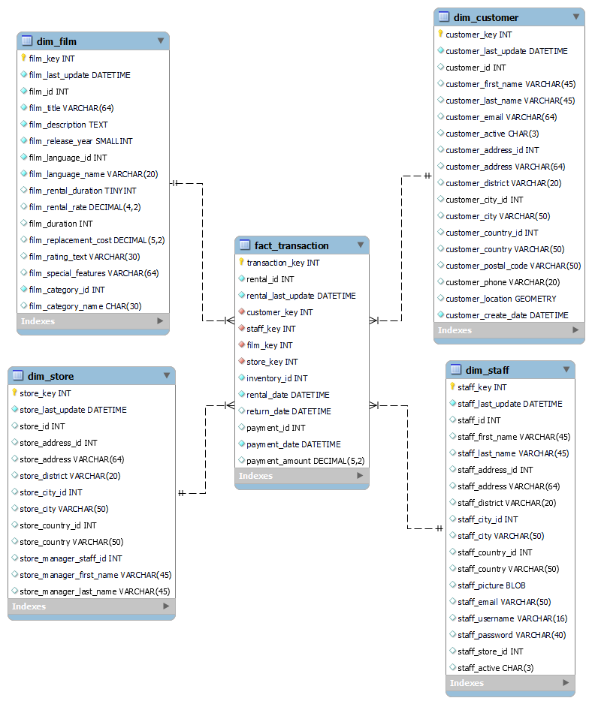
New Star Schema of Sakila Database

Slide 5
Overview new Star Schema of Sakila Database
Contain of 5 Tables (1 Fact Table and 4 Dimension Tables)
Focusing on Rental Transaction Film Table
Easy to querying data and integrating from another table to another table
Can’t include actor data in new database

Slide 6
Rental Film Transaction
Contain fact rental challenge, inventory, payment
Contain last update change
transaction_key is primary key

Slide 7
Customer Dimention Table
Contain customer personal data
Contain last update change
Primary key is customer_key

Slide 8
Store Dimention Table
Contain store data property
Contain last update change
Store_key is primary key

Slide 9
Staff Dimention Table
Contain staff data property
Contain last update change
Staff_key is primary key

Slide 10
Film Dimention Table
Contain film data property
Contain last update change
file_key is primary key

Slide 11
02
Create airflow DAG that transforms data from Origin Sakila Schema to your new Star Schema that runs daily

Slide 12
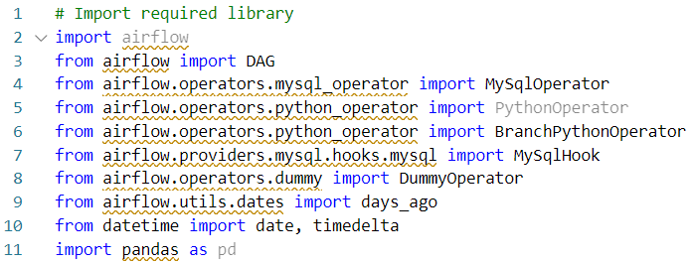
Import Required Library

Slide 13
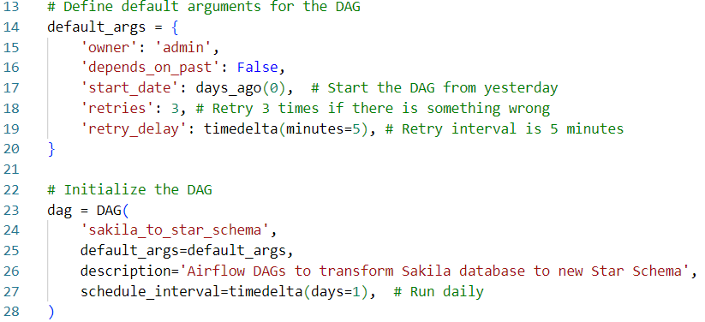
Define default arguments and initialize DAGs

Slide 14
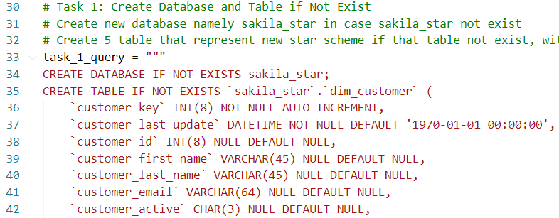
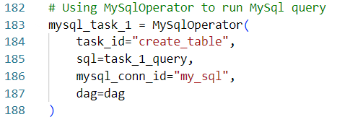
Task 1 – Creating Database and Table if not exist

Slide 15
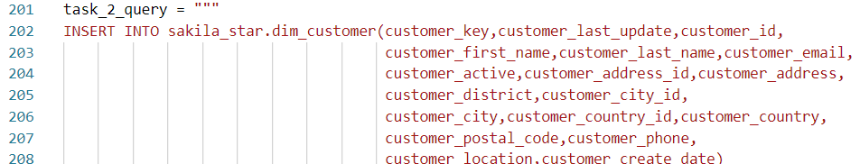
Task 2 – Inserting Data to Table Dimension Customer

Slide 16
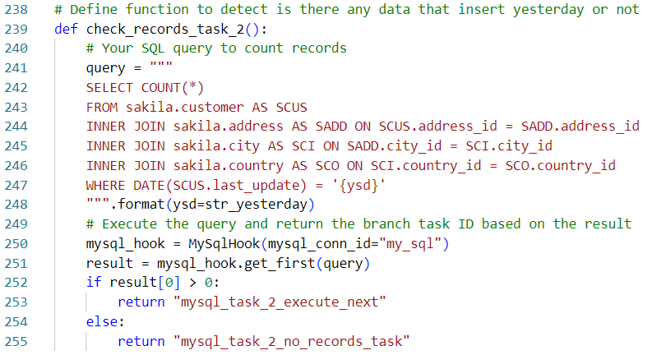
Task 2 – Inserting Data to Table Dimension Customer

Slide 17
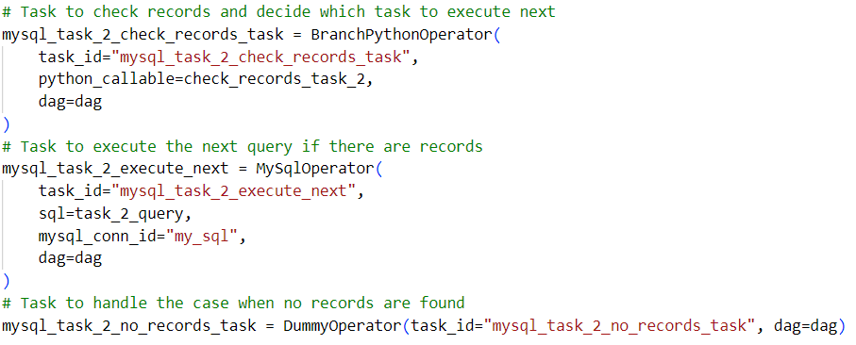
Task 2 – Inserting Data to Table Dimension Customer

Slide 18
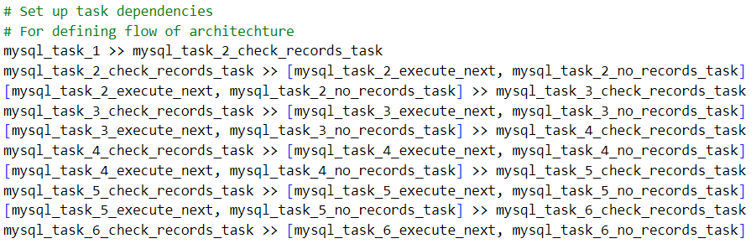
Task 3 – Task 6 (Quite repetitive and have same concept)
Setting up Dependencies

Slide 19
03
Create sample queries that demonstrate the difference between origin schema vs star schema for the same output

Slide 20
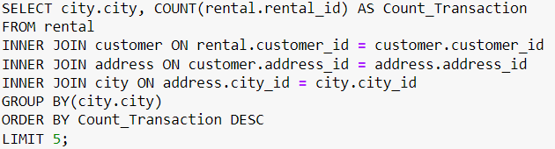
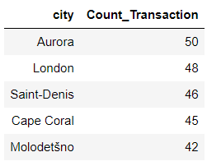
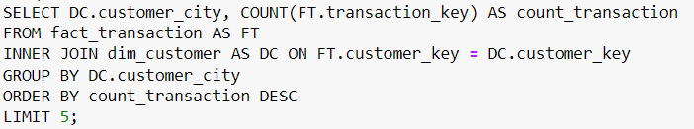
Find Top 5 Customer Cities
Old Database
New Database

Slide 21
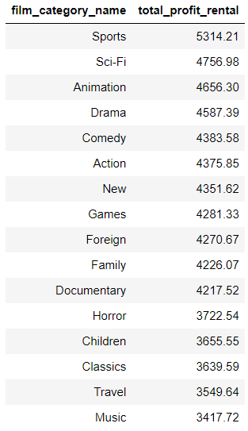
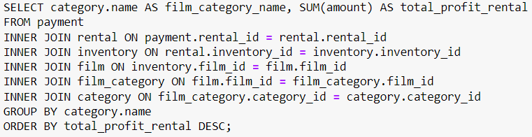
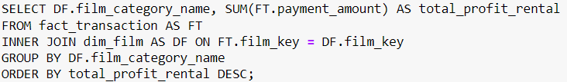
Find Most Profitable Genres
Old Database
New Database

Slide 22
04
Create the Data Warehouse Architecture

Slide 23
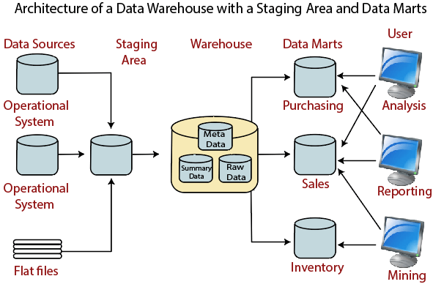
Data Warehouse Architecture: With Staging Area and Data Marts

Slide 24
Using Google BigQuery as Data Lake, Data Warehouse, and Data Marts
DATA LAKE
The datalake is in the form of one GCP project per environment, in each project a set of datasets and in each dataset of tables and views.
In this storage area, we are not talking about “business gestures” but only applications, so we will not be talking about sales, HR, etc. data here, but rather data from the order management application, for example.
The data is in flattened format and no modification is made to it (Raw data).
Unstructured data is stored in the Cloud Storage buckets.

Slide 25
Using Google BigQuery as Data Lake, Data Warehouse, and Data Marts
DATA WAREHOUSE
Business actions oriented: the data is organized by themes, also called “business actions” (orders, sales, HR, etc.) and should never be organized by application.
Integrated: Heterogeneous data from disparate sources is cohesively integrated and ready to use.
Chronological: a data warehouse must make it possible to analyze the evolution of data over time thanks to historization.

Slide 26
Using Google BigQuery as Data Lake, Data Warehouse, and Data Marts
DATA MARTS
Data Marts normally store transactional data in rows and columns, making it easy to access, organize, and understand data. Since they store historical data, they make it easy for data analysts to understand data trends.
Usually Vault Schema, Star Schema, and Snowflake Schema.
All KPIs (or new metrics for specific analysis) are calculated here.

Slide 27
05
Create Data Visualization based on the created Star Schema

Slide 28
Visualization of Database

Slide 29
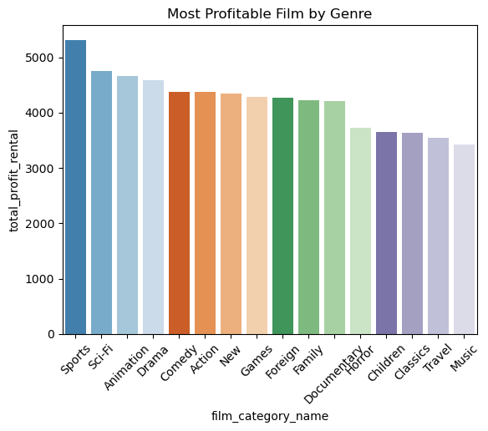
Most Profitable Film by Genre

Slide 30
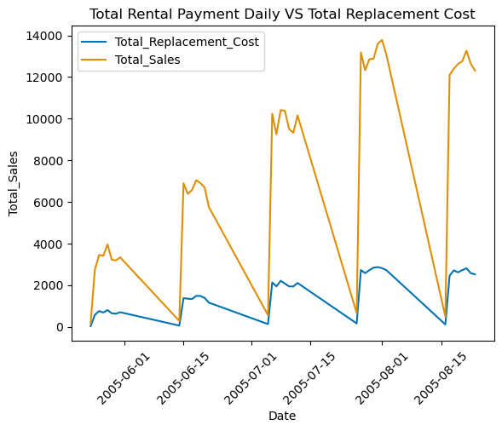
Most Profitable Film by Genre

Slide 31
06
Machine Learning https://github.com/Jauhar-Hakim/Data-Engineer-Test

Slide 32
Thank You!

